Slide 1








Building Future Cities
Theme: Smart City: Public Participation
URBAN
REPAIR
Team: The Unknowns
Team Members:
Arti Kumari
Sumit Rai
Geeta
Build Tomorrow

Slide 2





MOTIVATION
Cleanliness, property damage, etc. in a city that often go overlooked for a
long period of time.
1
Collaboration makes it easy to address a problem that is diﬃcult to address on an individual level.
2
3
Empower everyone to bring attention to pressing problems in city.

Slide 3
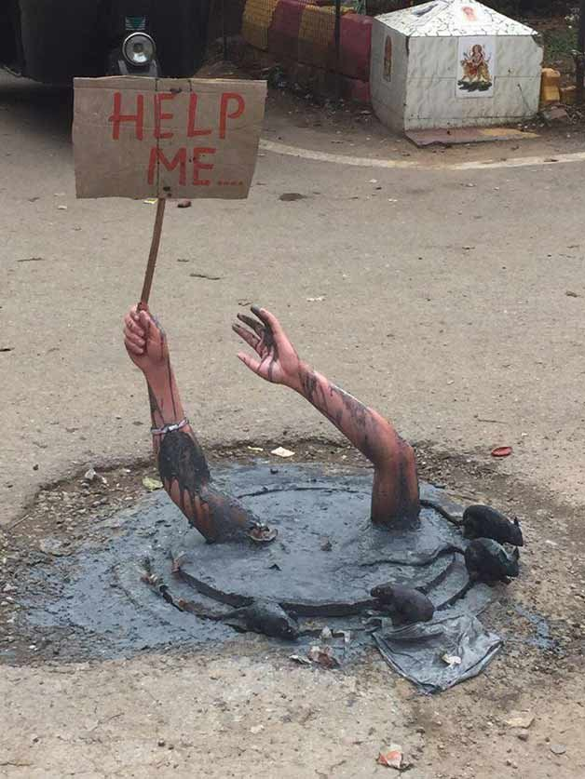
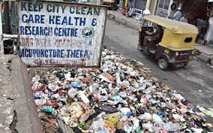
Problem Statement
Civic issues in Bengaluru: Easy to complain, but hard to resolve!
Garbage Dump on streets
Water Leakages
Open potholes
Damage Street Lights etc.
A citizen submit a complaint
Forward complaints to concerned departments.
Complaint -> Closed (Call centre people confirms from complainant)
Many citizens contest issues are rarely addressed properly
Reason behind it
Budget Constraint
Man power Constraint
Issues not reported
Citizen think fixing is Govt duty

Slide 4
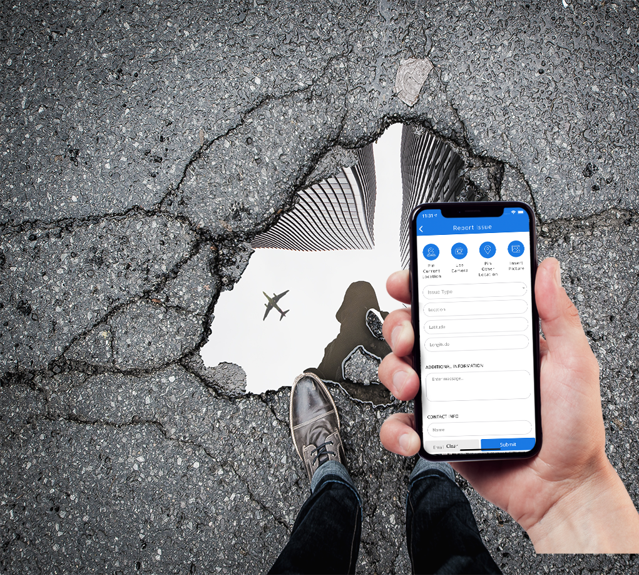
IDEA
Build a common platform for
Collaborate
Manage
Restructure
Repair
a city to improve the quality of life.
Citizen will contribute
Report issue
Resolve issue

Slide 5
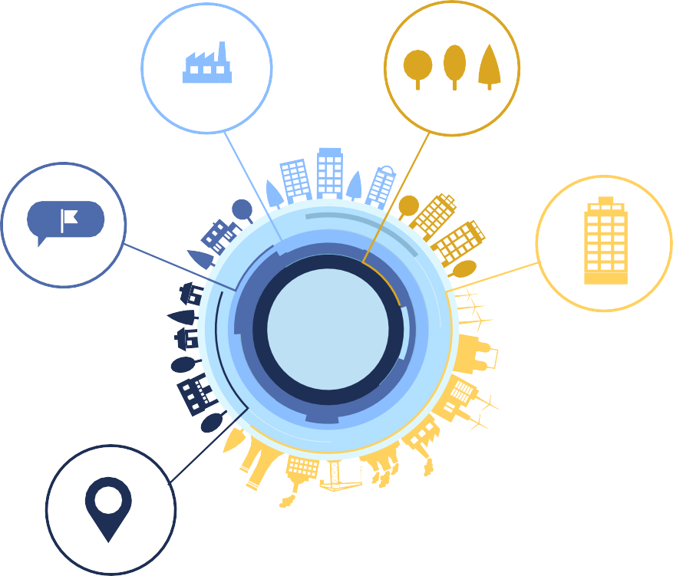
FEATURES
USER A: REPORT
Reports an ongoing issue
INCENTIVE
Incentives user A & User B depending upon the issue & fix.
FEED
Latest feed browsing containing all the recent issues along with images uploaded
MARKER PINS
Markers are placed on the map tied to each incident, which can be clicked to reveal an image and information about the incident
USER B / Concerned Authority
Take Action to fix the issue.
Close issue by confirming USER A

Slide 6








5
Action to resolve the issue
6
Got Incentive
If chosen, will be added in resolver group
2
2
1
Found dumps in city
Decided to report
4
Notify reported issue
Option to act as Resolver person
1
Onboarded on platform
3
Report through app
Blockchain based Platform
Resolved
6
Got Incentive
4
Notify Reported issue
1
Onboarded on platform
5
Action to resolve the issue
Concerned Authority

Slide 7


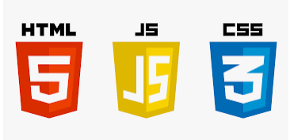








TECHNOLOGY STACK
Backend
Frontend

Slide 8
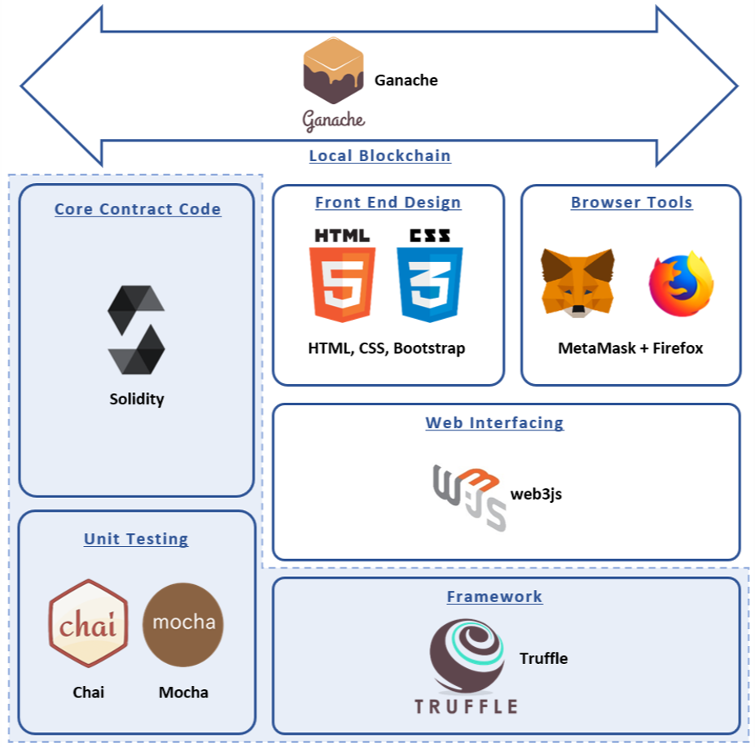

Slide 9
BUSINESS / REVENUE MODEL
INVESTORS: Govt., MNCs and large-scale organizations CSR type activities.
Earners: Reporter, Resolver, Platform
Why will Govt. invest?
To save cost and streamline cash flow in various departments including municipality.
To remove corruption and malpractices with money.
To give mobile employment to everyone at scale.
Urban Coins Trading opportunity!

Slide 10

BENEFITS
EFFICIENT FIX
Reporting & resolving issues efficiently
EMPLOYMENT
Opportunity of earning money by reporting & resolving issue
SECURE PLATFORM
User can report anonymously
RESPONSIBILITY DISTRIBUTION
Reduce efforts required from govt/employers to hire more employees to complete tasks
SOCIAL INCLUSION
Create social groups
IMPROVE CITY QUALITY
Address the issues and incidents happening around their city.
AWARENESS
Aware people about ongoing issue.
EFFICIENT FUND USE
Direct credited to resolver (No corruption)

Slide 11









SOCIAL IMPACT
AWARENESS
People’s awareness is an important key to development.
SOCIAL GROUPS
Development of groups paves the way for social inclusion to foster economic growth.
ENHANCED RESILIENCE
COLLECTIVE PLANNING
A key goal of urban land-use planning and policy is to ensure the ﬁnal development and use of the land is in the general public interest and all views are taken into account.
As cities grow, so does their
exposure and vulnerability to natural
disasters and accidents. Being
connected helps to mitigate the issues and build resilience overtime.
TERRITORIAL DEVELOPMENT
Allowing people to come forward and contribute to local development thus, opening up opportunities for global development.
Collective planning paves way to
mitigate conﬂict, facilitating
negotiation and conﬂict resolution.

Slide 12





FUTURE PLANS
GROUPS
Adding support for group discussion and planning.
EMERGENCY
A major addition would include having an emergency services feed/chat that would allow the city to help in a collaborative manner in time of need.
RAISING CONCERN
Raising concern and sharing opinions

Slide 13
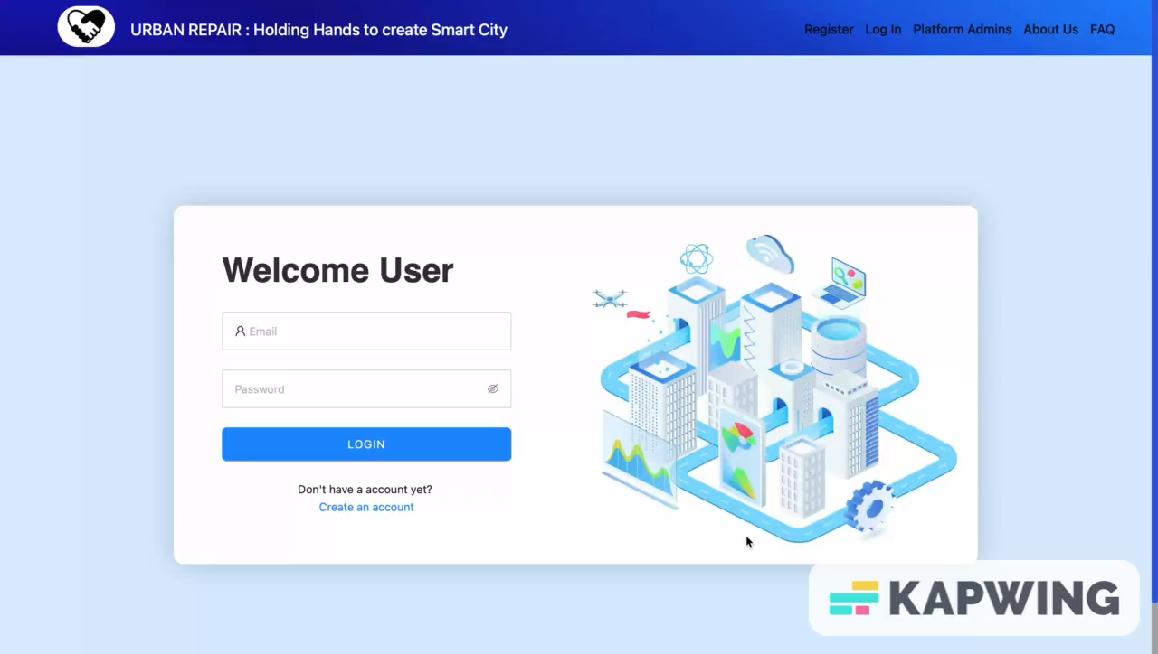
Demo Video: Link

Slide 14



THANK YOU

